Slide 1


DSA8023: Task 3
Group 9
Harikrishnan Unnikrishnan
Shlok Uday Satam
Thomas Edbrooke
Weixiao Huang
Notes:
Good morning Adele, this is Grop 9. And we will give a presentation on the third task of this module.

Slide 2
Scope
Scope
Task Analysis, Metrics of Success & Exec summary (Weixiao)
Data cleaning, Uni & Multivariate Analysis (Shlok)
Explaining & Exploring the model (Hari)
Findings, recommendations and limitations (Tom)
Notes:
This slide shows the structure of our presentation today. I will take charge of organising the project into manageable tasks, followed by our metrics of success and executive summary.
Shlok will then discuss data exploration in more detail.
Hari will explore the application of Long Short Term Memory (LSTM) model on market price forecasting.
Finally Tom will give our recommendations and discuss the potential limitations of our work.

Slide 3
Task Analysis
Data Exploration
Model building
Make a predicition
Data Processing
Choose market with best price
Cleaning, Formatting, Interpolation
Build LSTM models on 5 electricity markets
Compare and choose the most profitable market
Univariate & Multivariate
Analysis
Apply model on D-1 data
Notes:
To start with, we first began by formatting and interpolating data to prepare for following steps. Next, we investigated and visulized the data to discover the features and initial patterns of the dataset. After that, we build LSTM models and predict prices of the last day. Ant the end, on the basis of our comparison and selection of the most profitable markets, we achieve our conclusions and recommendations.

Slide 4
Metrics of Success
For the model
For the project
Training Loss Curve
Achieve a model making predictions rather than a perfect model
Root Mean Squared Error
Notes:
We have two methods to measure the performance of our model. We first focus on the loss changing when training the function. This curve decreases as the training process proceeds and then reaches a stable point. By observing the graphs, we should not spot underfitting or overfitting of the model, as these two are common pitfalls that we need to avoid. Another measurement approach is to calculate the Root Mean Squared Error(RMSE) between the prediction and our true values. The RMSE calculates the difference between these two values, hence the value of RMSE will display how our prediction is. However, due to the complexity of the project and large amount of variables, we are more focus on achieving a model making predictions rather than a perfect model, we will focus on optimization later and this is how we evaluate our model performance.

Slide 5
Executive Summary
Energia Supply plan to buy electricity from the All-Island market and the price across 5 markets are different
The goal was to build a model that would enable Energia to purchase electricity in the cheapest market through an integration of price prediction and market trend analysis.
The model can produce predictions using the given variables, to help identify the optimal market to purchase electricity at 30-minute intervals for D+1.
However, due to the complexity of the task and time constraints, we only manage to build a base model. Further optimization is required obtain a better prediction.
Notes:
The purpose of our current project was to develop a model to predict prices by analysing market trends, which could help Energia purchasing electricity at the best price among the 5 markets.
To make predictions, the model was trained on a dataset of historical sequence data. During training, the model learns to recognize patterns in the data and use them to make predictions about future values in the sequences. Once the model has been trained, it can be used to make predictions on new and unseen sequences.
However, because of the complexity of the task and time constraints, we only managed to build a base model, which could give predictions but still could be improved. Therefore, further studies need to be carried out in order to explore how the model can be optimized to obtain a better predictions.

Slide 6
The Data
Type of data: All 4 features were continuous; no categorical variables.
Missing rows: The demand data had a shape of (40510,4) which meant there were two missing rows for date 27/03/2022 @ 01:00:00 and 01:0:30. We assess these values to be missing completely at random(MCAR) as they were at the same time each year across all datasets.
Interpolation and treating NaN values: Interpolation was performed to fill the NaN values.
Final dataset: The fully merged dataset (including markets) had 39362 rows and 13 columns once formatted.
Outliers: For electricity and gas, it was observed that abnormal values were linked to import real-world events event.
Notes:
Type: Continuous – SO WHAT?
Missing rows: The demand data had a shape of (40510,4) which meant there were two missing rows for date 27/03/2022 @ 01:00:00 and 01:0:30. SO WHAT? MCAR SO WHAT?
Interpolation and treating NaN values : Interpolation was performed to fill the NaN values which use the previous non-missing entry to fill the missing values. SO WHAT?
Final dataset: The fully merged (including markets) had 39362 rows and 13 columns once formatted.

Slide 7
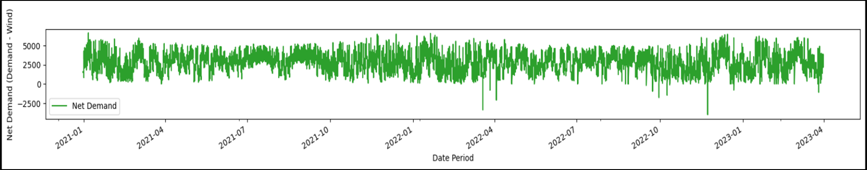
Univariate Analysis
The net demand was calculated: (demand-wind power)
In some instances, values go down to -2500 indicating that production has exceeded the demand.
Net Demand vs time plot
Notes:
ADD TITLE, EXPLAIN NET DEMAND!!!!!!!!

Slide 8
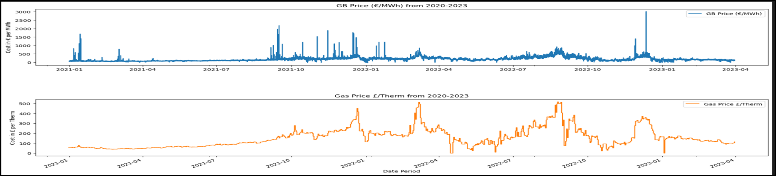
Univariate Analysis
Comparing the GB price/MWh and gas price/Therm from 2020-2023 shows a spike in prices during certain months, presumably due to conflicts between Ukraine and Russia followed by some seasonal changes (winter) and the energy crisis.
Notes:
SO WHAT????????? X2 feature with seasonal trends, two more linked to current affairs.

Slide 9
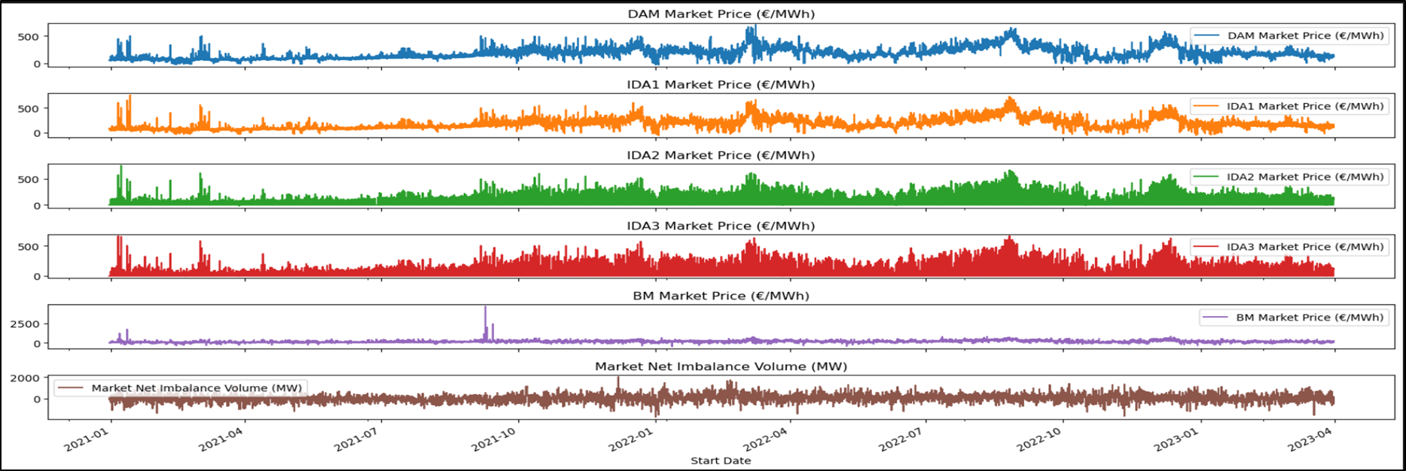
Univariate Analysis
BM most volatile whilst others roughly followed the same pattern.
This is because BM is based on adjusting supply or demand in real time depending on grid needs while other markets operate ahead of time where electricity is traded for delivery at a future time more stable and predictable prices.
Market Price Over Time Period
Market prices in (€/MWh)
Notes:
ADD LABEL TO Y AXIS
ANY OTHER POINTS: Other markets follow a similar trend, BM is more

Slide 10
Multivariate Analysis
Auto-correlation: Performed to find patterns or dependencies between observations such as net demand, gas/electricity price and all markets for time series. Observations for variables had positive correlations, indicating strong positive correlations between current values and past values
Stationarity: Performed using Dickey-Fuller test.
Decomposition: Analyzed the features by trend, seasonality, and residuals. For wind and prices of gas and electricity, there upward trends were observed while demand and net demand showed a decreasing trend. Seasonality showed two features wind and demand (net_demand) had strong seasonal patterns which coincides with the findings of univariate analysis.
Notes:
CORREL
AUTO CORRELATION: Coefficients were calculated for variables such as net demand, gas price, electricity price and all of the markets at lags of 1, 3, 6, and 12 months to measure the degree of correlation between the variables at different time lags

Slide 11
The Model: Approach
Initial modelling
LSTM, ARIMA
Build model for single market
Final model
Optimize the model with best results
Predict values for all markets
Data split
Train data
Validation data
Test data
General Approach
Predict prices of all markets using single model
3 model approach
Use data as it is
Interpolate the zero values
Interpolation for IDA2 and IDA3 markets
Impute using median
IDA2 and IDA3 market approach
Fill zeros in a particular day with average market value of the day
Notes:
The input data was split into train, validation and test.
The model was trained on the train data, validated using validation data and the last 48 records which had 48 time intervals for a day was used as test data to compare the predictions
Each of us looked into multiple models such as LSTM and ARIMA. We then tried to build a model to predict the price of a single market.
We were able to achieve the results with one LSTM model, which we optimized and used it to predict the prices of all other markets.
Initially we tried using the model to predict prices of all markets together but later moved on to 3 models – one for DAM, IDA1 and BM markets (because they have same time intervals) and two other, one for IDA2 and another for IDA3 market since they followed different time intervals.
For markets IDA2 and IDA3 which were not open at all times, we took two approaches –
one was to use the data as it is, train and test the model
Second was to interpolate the zero values for times when the market was closed.
We performed this interpolation in three ways -
First we tried to impute using the median market value for all zero records
Second, we tried to fill the zeros in a particular day with the average market value of the day
Third, we filled the zeroes in a day with the median value – which gave the best results.

Slide 12
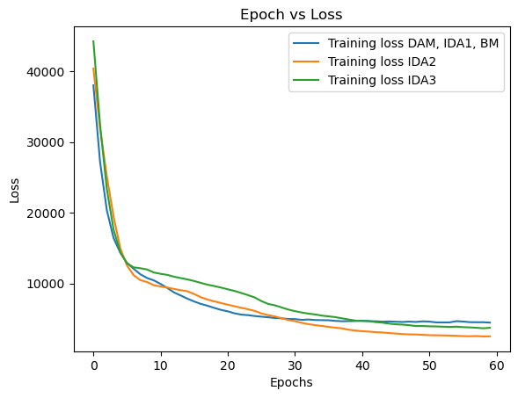
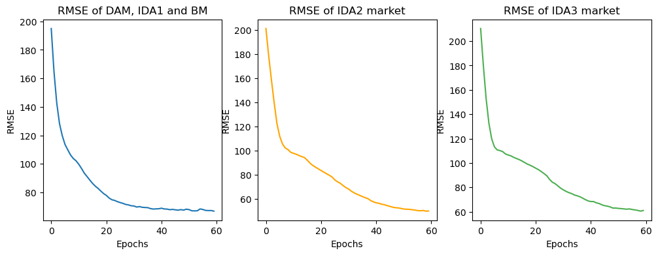
The Model: Results
MODEL 3M | MODEL IDA2 | MODEL IDA3
DAM, IDA1, BM market | IDA2 market | IDA3 market
Final RMSE: 31.95 | Final RMSE: 23.29 | Final RMSE: 41.66
Notes:
The plot on the right shows the training loss for the model and we see that the loss stabilizes after 60 epochs.
Root Mean Square Error (RMSE) were checked to assess the models and we see from the plots below that although RMSE values are high, it is decreasing.

Slide 13
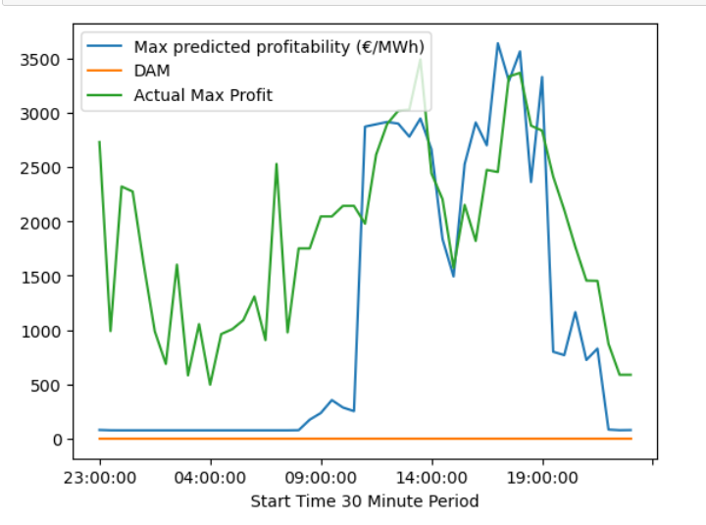
Findings Based on Predictions vs Actual Prices
Actual & Predicted Profitability: 31 March 23
Actual & Predicted €/MWh : 31 March 23
Time 31/03/23 | IDA1 €/MWh Actual | IDA1 (p) €/MWh Pred | BM €/MWh Actual | BM €/MWh Pred
22:00:00 | 121 | N/A | 102 | N/A
22:30:00 | 113 | N/A | 94 | N/A
23:00:00 | 160 | 129 | 91 | 131
23:30:00 | 160 | 124 | 169 | 126
Profitability per 100MWh (Euro)
Notes:
This slide first answers the question: Assuming Energia have 100MW of electricity to buy in each half hour of the day, How can they optimise the purchases in ISEM (compared to buying everything in DAM) using our model.
The graph below shows the model’s predicted most profitable choices across the four markets (as DAM is the baseline) vs the actual for D+1, in this case 31 March 23 which was our test date.
The model clearly stalls until the 1100am mark where it begins to track along the actual trend.
Examining the model’s recommended market by intervals showed it uniformly selected IDA1 until around 0800, where it switched to BM until selecting IDA2 at 1100am. Examining the predicted values showed the model tended to significantly under estimate the cost of IDA1 energy prices during this time, whilst overestimating DAM and BM. This demonstrates a limitation of a basic LSTM model, which uses memory from previous data to inform it’s next decision in the time series.
Prior to the markets opening which represented the end of the model’s training data, IDA1 had a relatively low price, as can be seen by the table on the right. The model was unable to account for the sudden jump, which likely led to a stall in its performance whilst it read new data to recalibrate its weights. It then appears to over correct and thus select BM until IDA2/3 became viable options. These markets were relatively stable before the market opened and likely perceived as safe bets, especially as each of these markets’ predicted values were trained on independent models, so the volatility in other markets wouldn’t have factored into predictions.
Examining the raw values also demonstrated the model was suspicious of more volatile markets such as BM, which may actually be more profitable. As a result, the model tended to set higher values for BM on average, as can again be seen on the right.
Given these findings and the current state of the model, the optimate strategy would be to currently only use the model to supplement purchasing decisions for after 11am, as the model lags behind if sudden changes occur after training.
Additionally, the fact the model is conservative helps address the second question seeking to minimise loss above 50K. Until further tuning is performed, we’d recommend using the model to only estimate IDA and DAM markets. Whilst potentially the least profitable they are also the most stable and least likely to cause losses due to volatility

Slide 14
Limitations & Recommendations
Limitation: We weren’t able to pre-process the data in a way that did not negatively affect model performance. Recommendation. Try to identify ways to transform the data to improve predictions and minimise RMSE.
Limitation: Basic LSTMs can struggle to identify complex predictive trends. Recommendation. Use more advanced model architecture to improve model performance.
Limitation: Our model significantly underperforms in the first 8 periods of the market. Recommendation: Create additional features to help the model understand market volatility.
Notes:
Ultimately, whilst our model is a useful proof of concept, it doesn’t yet satisfactorily address Energia’s business problems at the required level of fidelity. We’ve therefore paired our limitations with an appropriate recommendation to act as “next steps” to optimise the model and better answer the given questions.
First, we were able to apply techniques such as normalisation to help with data pre-processing. We recommend this is investigated to identify more suitable techniques to aid with the model’s performance.
Second, as our metric of success was to produce a working model, we didn’t focus too much on optimisation; this must addressed to improve predicative performance.
Thirds, it is difficult to state how the features are for training ML models and therefore devise a clear market strategy. It may be worth exploring how additional data such as an energy market volatility could be added to the model to increase its performance.

